Slide 1
Upchain Server i18n
Xing Lang 2023.08.03

Slide 2
目录
What
Why
Old solution
优点
缺点
Current solution(front-end i18n)
优点
缺点
Server i18n
优点
缺点
How

Slide 3
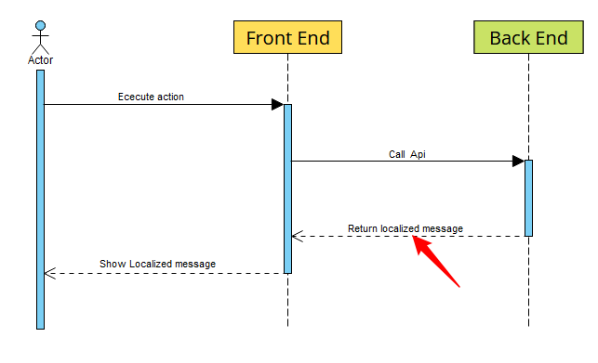
1. What is server i18n.
Back end can return localized message when front end call back-end Api.

Slide 4
2. Why

Slide 5
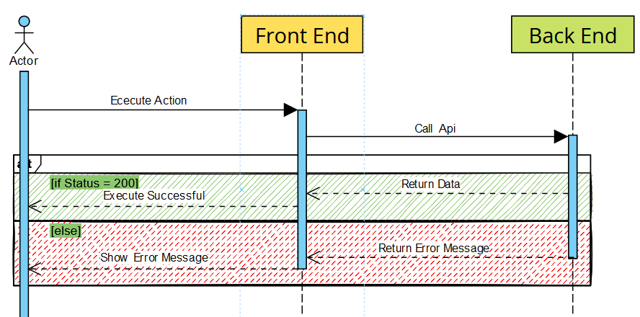
2.1 Old solution
优点
缺点

Slide 6
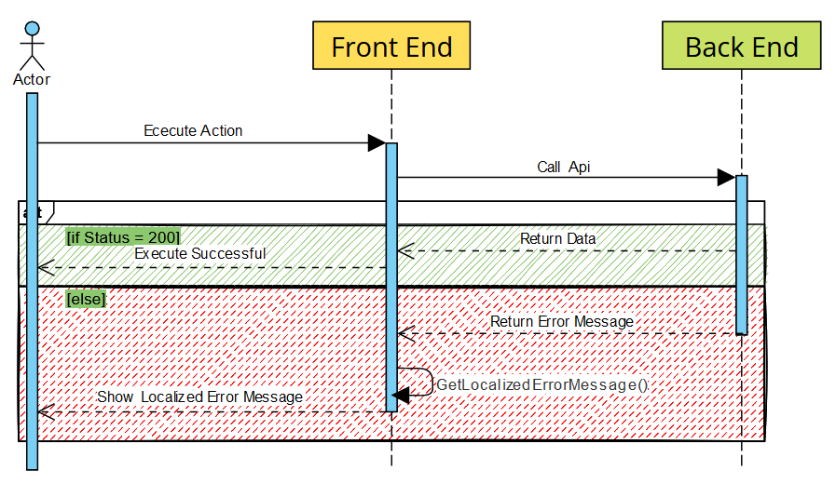
2.2 Current solution
优点

Slide 7
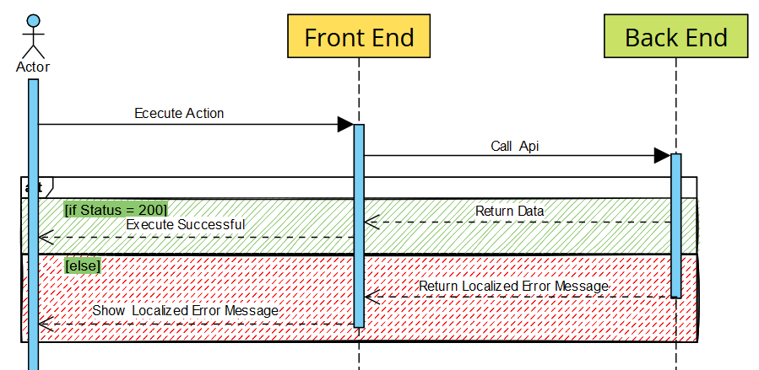
2.3 Server i18n

Slide 8
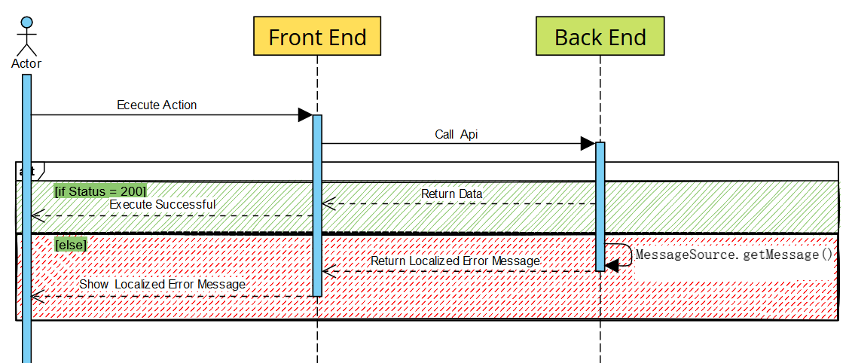
How to do the server i18n

